Slide 1
Maths
Unit 8 – Addition and subtraction.
WALT:
6Nf.09 – Estimate, add and subtract numbers with the same or different numbers of decimal places.

Slide 2
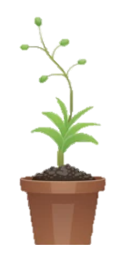
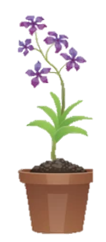

WALT: Estimate, add and subtract numbers with the same or different numbers of decimal places.
I can complete addition and subtractions using the written method.
I can answer worded problems.
I can explain the mistakes of others in their working out.

Slide 3
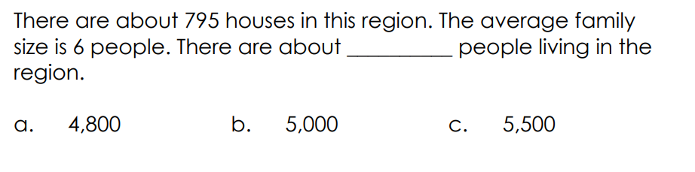
Retrieval Practice
WALT: Estimate, add and subtract numbers with the same or different numbers of decimal places.

Slide 4
Starter – What do the following mean?
WALT: Estimate, add and subtract numbers with the same or different numbers of decimal places.
Compose
Decompose
Regroup

Slide 5
I do – 451.86 + 239.03 =
WALT: Estimate, add and subtract numbers with the same or different numbers of decimal places.
 |  |  | .

Slide 6
You do – 165.321 + 204.565 =
WALT: Estimate, add and subtract numbers with the same or different numbers of decimal places.
 |  |  | .

Slide 7
I do – 943.243 - 312.029 =
WALT: Estimate, add and subtract numbers with the same or different numbers of decimal places.
 |  |  | .

Slide 8
You do – 637.293 – 394.189 =
WALT: Estimate, add and subtract numbers with the same or different numbers of decimal places.
 |  |  | .

Slide 9
WALT: Estimate, add and subtract numbers with the same or different numbers of decimal places.
Mr. Josh is working out 45.203 + 54.437.
He says, “ My answer is must have 5 digits because the numbers I am adding all have 5 digits.”
Is he correct?

Slide 10
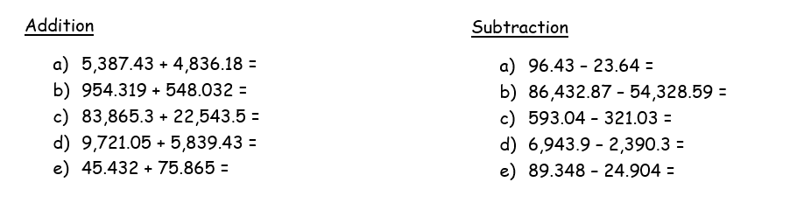
Your task – In your books, complete the calculations using the written methods.
WALT: Estimate, add and subtract numbers with the same or different numbers of decimal places.

Slide 11
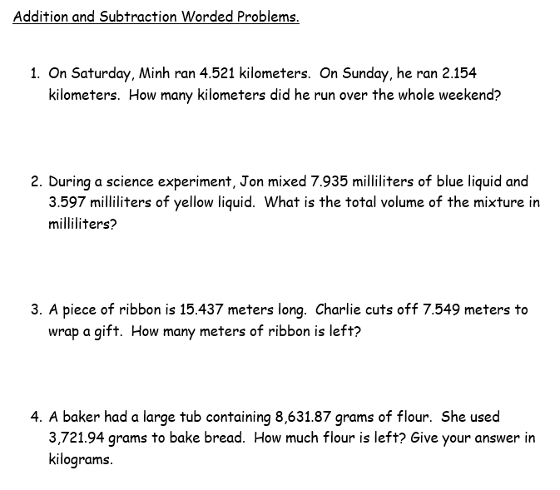
WALT: Estimate, add and subtract numbers with the same or different numbers of decimal places.

Slide 12
WALT: Estimate, add and subtract numbers with the same or different numbers of decimal places.
I can create my own additions and subtractions with dice.
I can complete my own additions and subtractions.
I can add and subtract numbers with a different number of decimal places.

